Slide 1

Analysis of monthly energy consumption by customer type and ZIP Code in Nashville TN
By
Peter Busienei
Notes:
We define electricity intensity as electricity demand per person or dollar of economic activity. We argue that falling electricity intensity is driven largely by increased energy efficiency. Increases in efficiency across industrial, commercial and household sectors have arrested the growth in electricity consumption.

Slide 2

Facts
Nashville Electric Service(NES) is one of the 12 largest public electric utilities in the nation, distributing energy to more than 400,000 customers in Middle Tennessee.
Average price of electricity: 10.65 ¢/kWh
Average monthly usage: 1,238 kWh per customer (2nd highest in the nation)
Average monthly bill: $129 (7th highest)
Notes:
1922 - Nashville's street car company merges into a new entity called the Tennessee Electric Power Co. (TEPCO).
1938 - TEPCO sues the Tennessee Valley Authority for trying to sell power in Nashville.
1939 - TVA wins the lawsuit and buys TEPCO for $79 million. Five-hundred employees of TEPCO become employees of the newly created Nashville Electric Service.
1950 - Construction begins on NES' headquarters at Church Street and 13th Avenue.

Slide 3
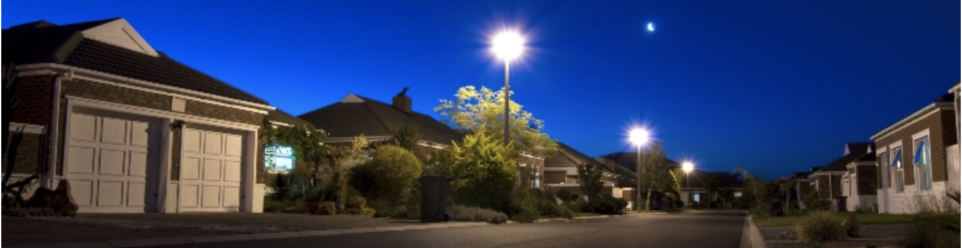
Nashville electric service(NES) customers
Residential: services for individual homes on permanent foundations, that are not part of a park.
Commercial: services to permanent commercial or industrial structures, outbuildings on residential property (barns, shops, pump-houses, garages, etc.), or any three-phase service whether it is for residential or commercial use.
Outdoor Lighting: services for outdoor security lighting to create a safer environment for homes or business. Lights can be installed on existing utility poles or on specially placed poles based on the necessary level of lighting.
Seasonal: Services offered as needed, such as during holiday seasons, Christmas tree stands, Christmas lights in Lebanon
Notes:
NES will visit your property to design a lighting plan tailored to your needs

Slide 4
Agenda
Classify consumers to different types
Analyze trends and total annual electric consumption
Analyze average annual/monthly energy consumption
Show average annual energy consumption per customer type
Show insights from the data for NES average energy consumption by zip code
The 10 highest and lowest energy consuming zip codes and any key influencers

Slide 5
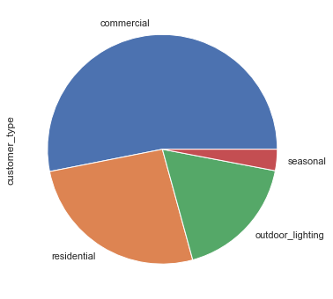
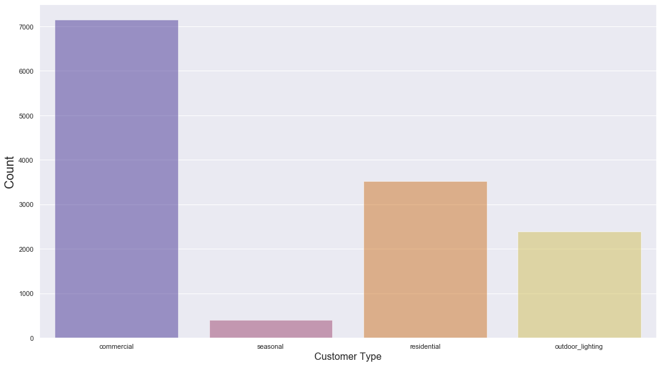
Who’s the highest consumer?
51%
4%
27%
18%

Slide 6
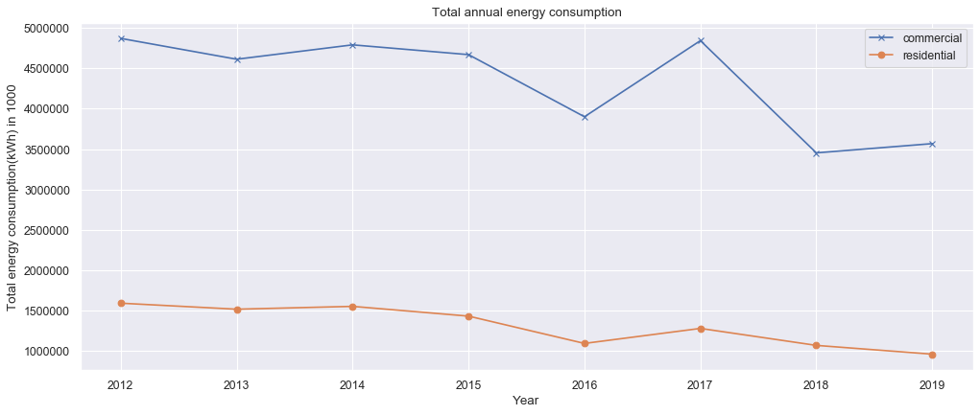
Annual Energy consumption by commercial and residential customer
Notes:
Highest year being 2012, there is a decline trend lowest in 2019 as per the updated dataset on December 20, 2019

Slide 7
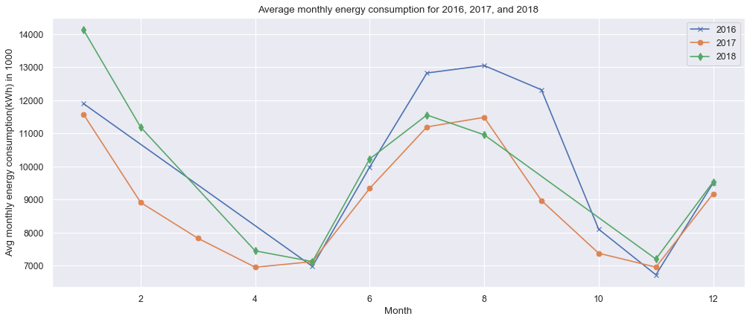
Year 2016,2017 or 2018 an outlier?
Notes:
Highest year being 2012, there is a decline trend lowest in 2019 as per the updated dataset on December 20, 2019

Slide 8
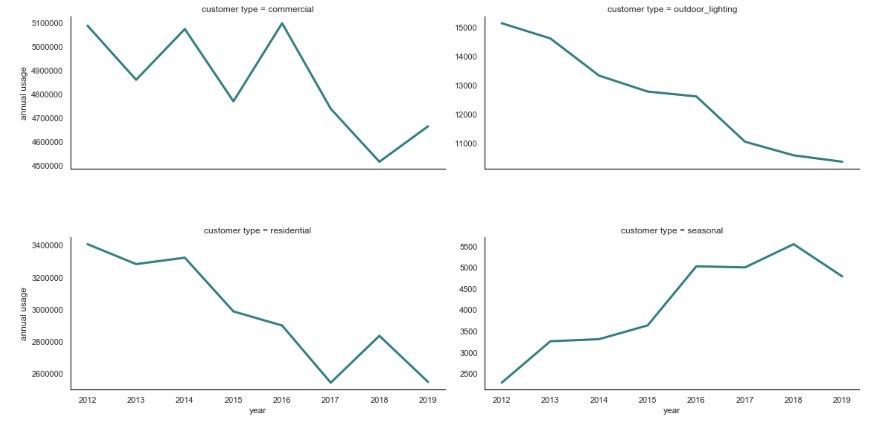
Avg annual energy consumption by customer type
Notes:
Based on the above annual consumption I wanted to drill in to check differences in monthly energy consumption

Slide 9
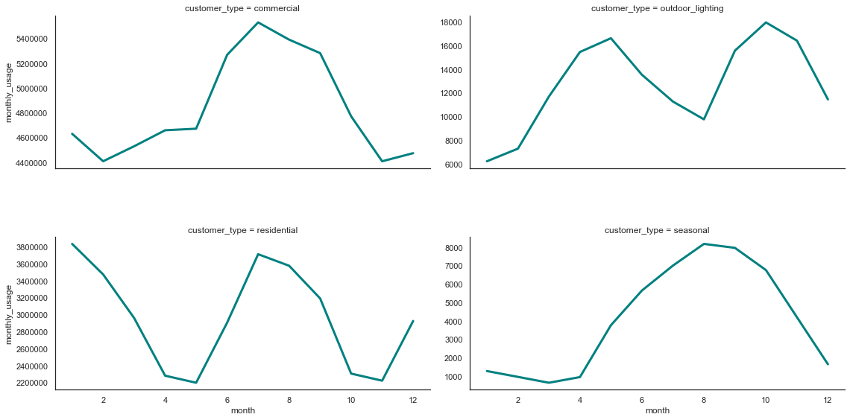
Avg monthly energy consumption by customer type
Notes:
July-August _residential, commercial, seasonal-start of warm weather
April and October- Outdoor customer-interesting
Why a spike in June to October?

Slide 10
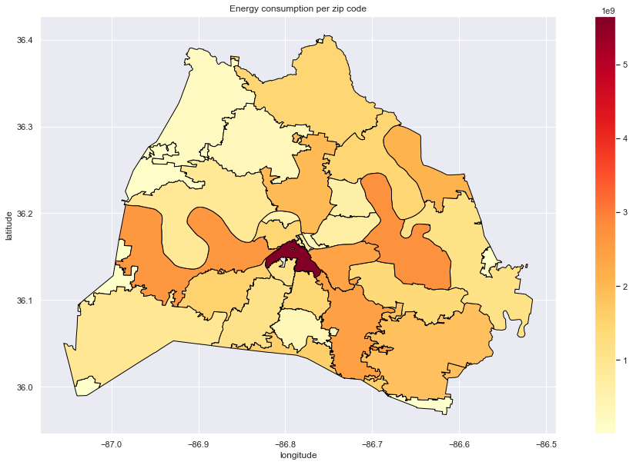
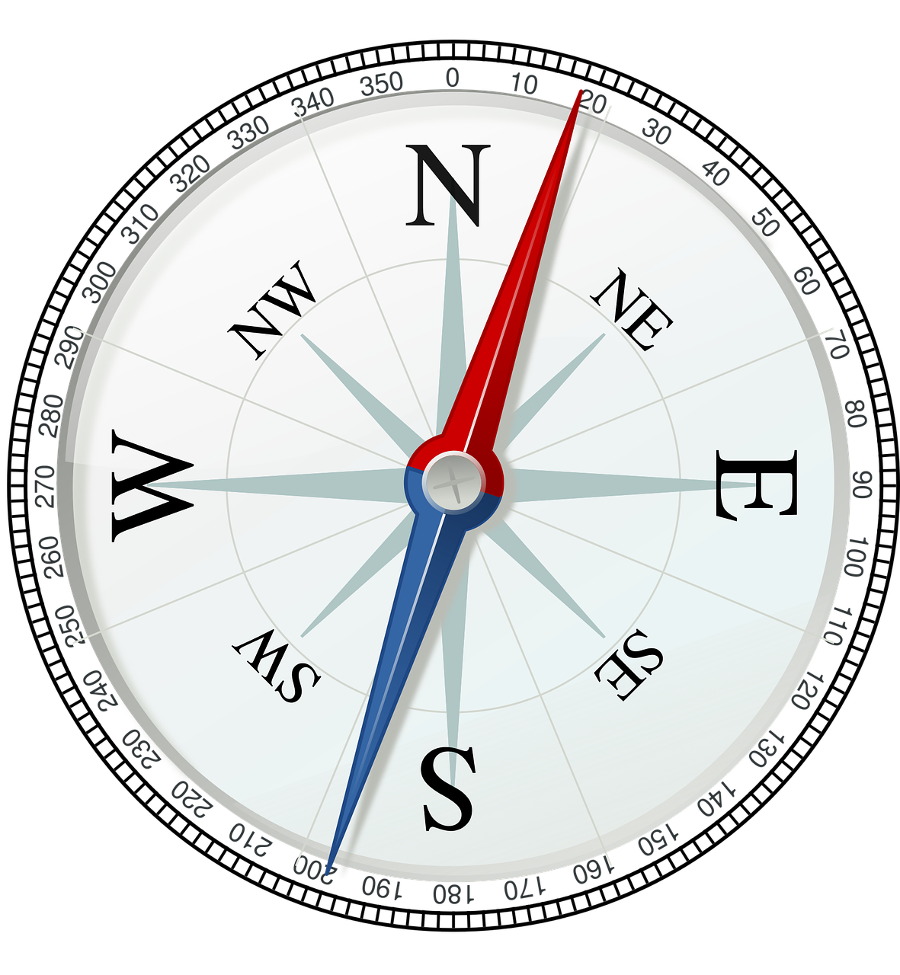
Total energy consumption per ZIP Code
NSS
Notes:
What’s happening in 37203?

Slide 11
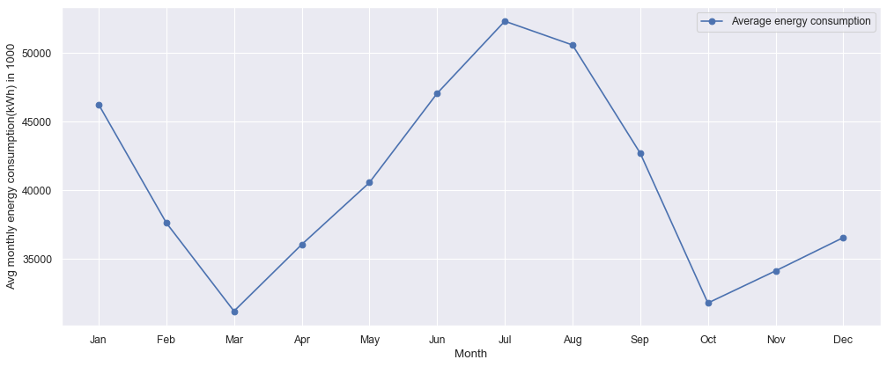
Residential customer avg monthly energy consumption (kWh)
Notes:
My focus from here is the residential customer
March and Oct- mild weather
Decline in average energy consumption

Slide 12
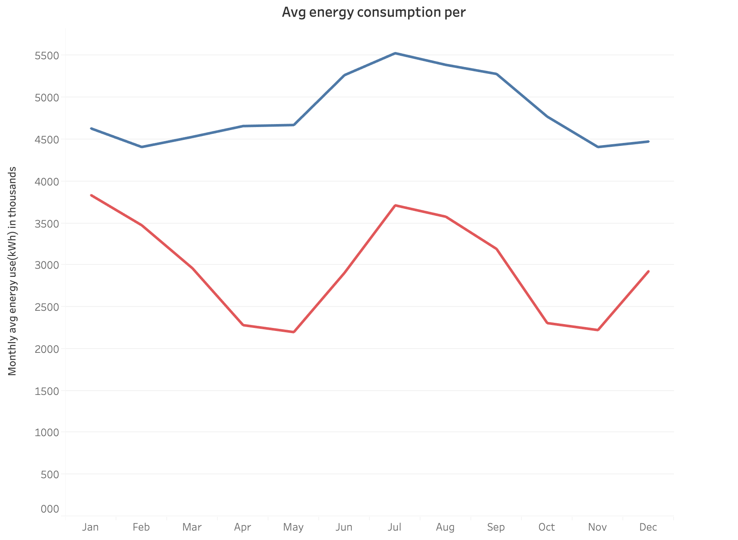
Avg monthly energy consumption (kWh)
Commercial customer
Residential customer
month
Notes:
compared to the commercial customer the trend seems to be the same

Slide 13
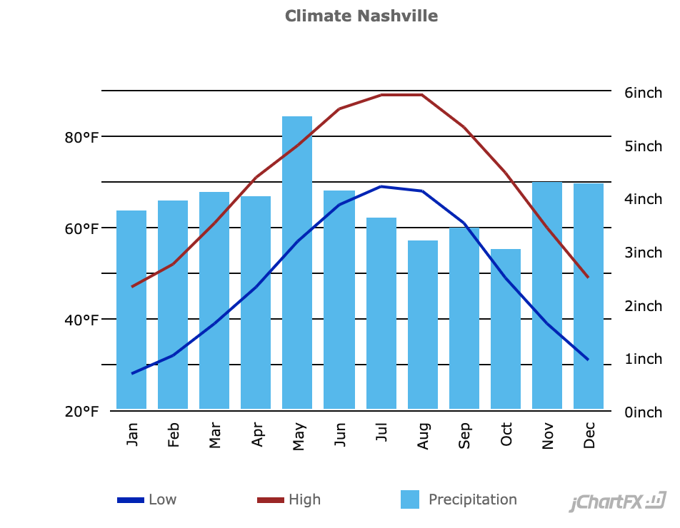
Nashville weather?
Notes:
Based on the pattern before, it seems like the energy consumption coincides with the warmer weather
Now that we know that the weather could be a factor, I explored other possible influencers to high energy consumption

Slide 14



Any key influencers of residential ZIP Code energy consumption?
Population
Median income
Median age
Unemployment
Median home price
Notes:
Research finding has shown these variables to have impact on economic and demographic factors
No correlation
visuals on appendix

Slide 15
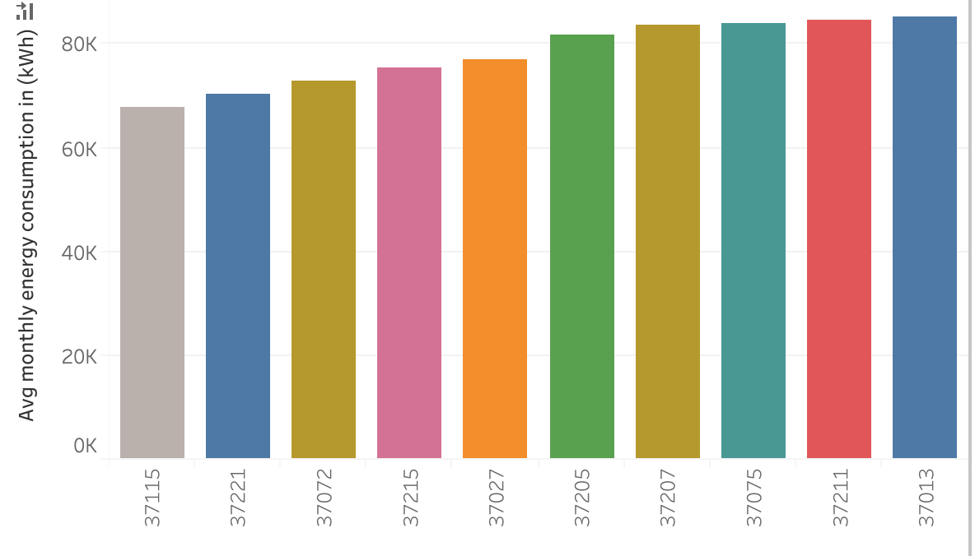
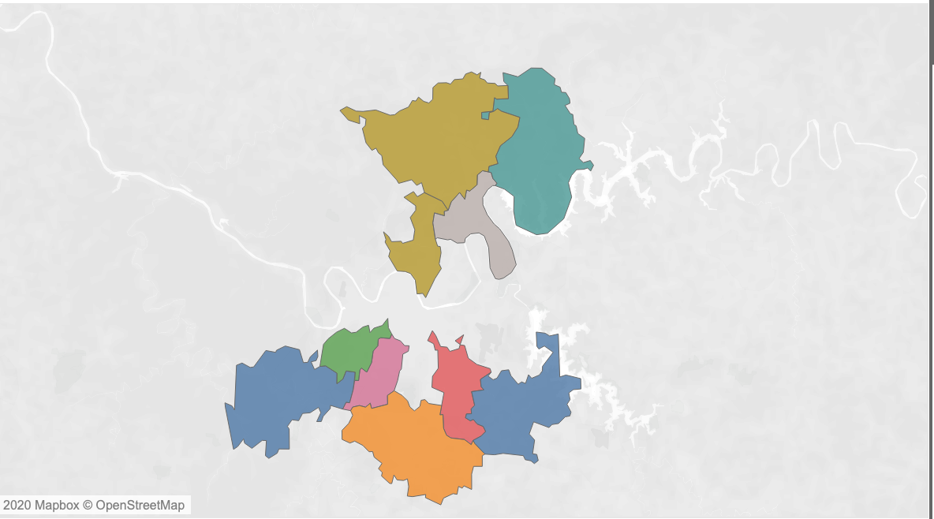
Top 10: Is there a relationship with proximity?
37221
37013
Notes:
I found the zip code to be aggregated and in proximity to each other

Slide 16
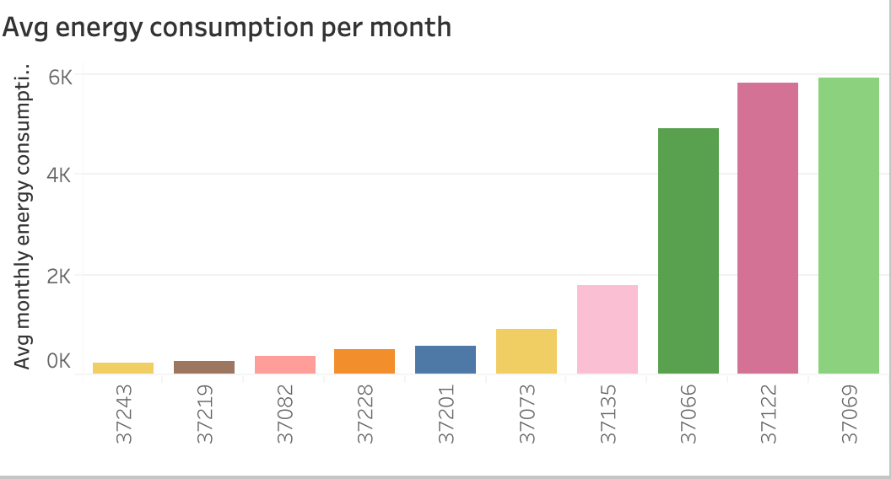
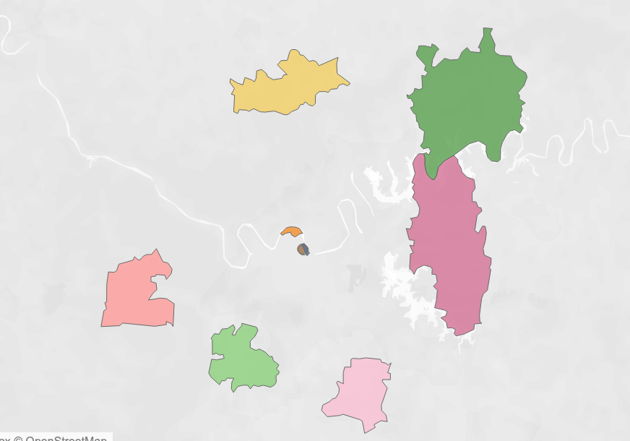
Is there a relationship with proximity for lowest 10 ZIP Codes?
Notes:
Locate energy consumption to zip code proximity
Nothing standing out!

Slide 17
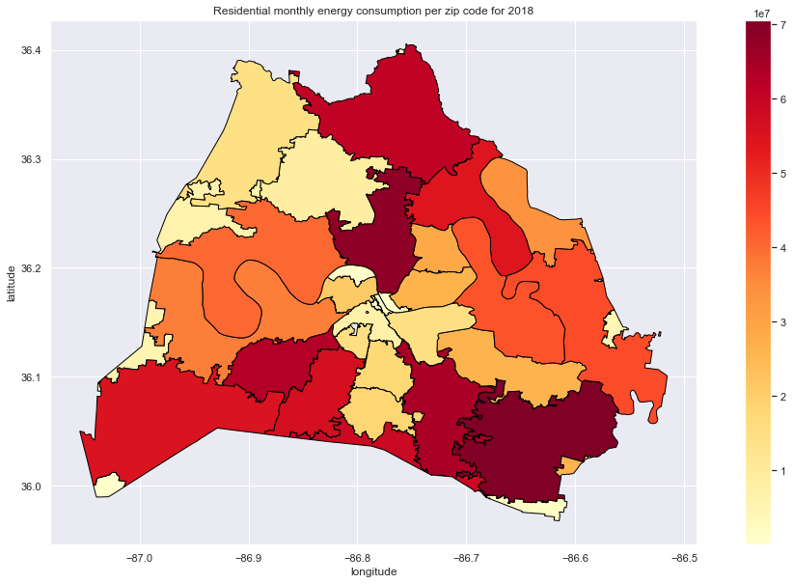
How is energy distribution over the ZIP Codes

Slide 18
Recommendations
Further analysis need to be done on the age of the homes, energy efficiency
Know the different home electric equipment in a ZIP Code
The square footage of residential homes

Slide 19
References
Data.Nashville.gov (https://data.nashville.gov/Energy-Usage/NES-Monthly-Energy-Consumption-by-Customer-Type-an/vbx7-mn5i)
U.S. Energy Information administration( https://www.eia.gov/)
United States zip codes(https://www.unitedstateszipcodes.org/)
Choose energy (https://www.chooseenergy.com/news/article/the-states-that-use-the-most-and-least-amount-of-energy-per-household/)
Statistica (https://www.statista.com/statistics/807951/average-monthly-electricity-usage-in-major-us-cities/)
Nashville Electric Service https://www.nespower.com

Slide 20
Tableau viz
https://public.tableau.com/profile/bush1897#!/vizhome/EnergyConsumption_15781937576950/myDashboard1?publish=yes

Slide 21
Tableau viz
https://public.tableau.com/profile/bush1897#!/vizhome/EnergyConsumption_15781937576950/Mydashboard?publish=yes

Slide 22
Thank You!

Slide 23
Appendix

Slide 24
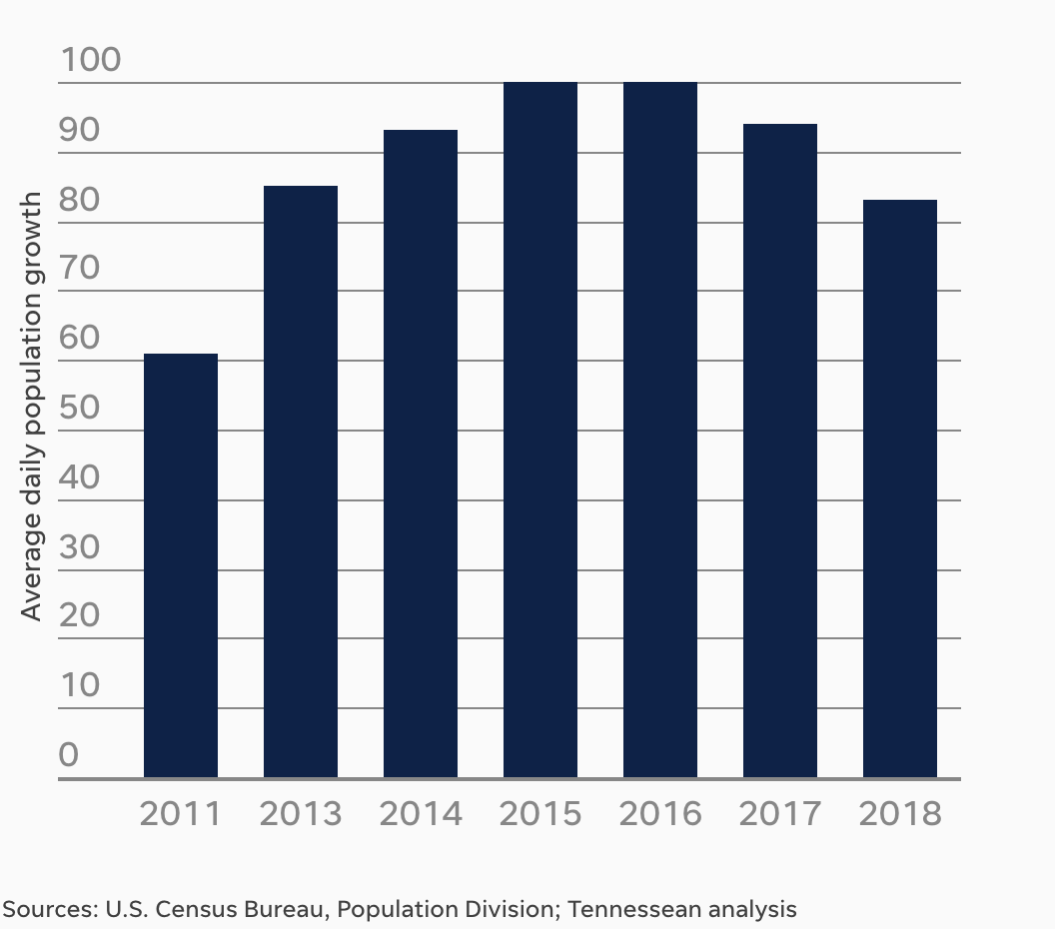
Nashville daily avg population growth

Slide 25
Challenges
The ZIP Codes with less than 100 NES customers was not displayed by NES for privacy reasons.
Most Nashville open data has many variables removed to protect the identity of individuals.
The data provided have few variables to consider during analysis, hence the limited scope.
The data does not provide square footage of the residential houses.
There is no different category types of residential houses.
Notes:
It would have been interesting to see residential homes broken into different square footage and how each consumes energy.

Slide 26
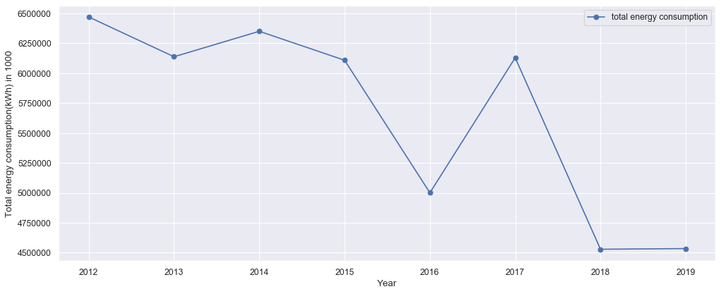
Annual energy consumption
Notes:
Highest year being 2012, there is a decline trend lowest in 2019 as per the updated dataset on December 20, 2019

Slide 27
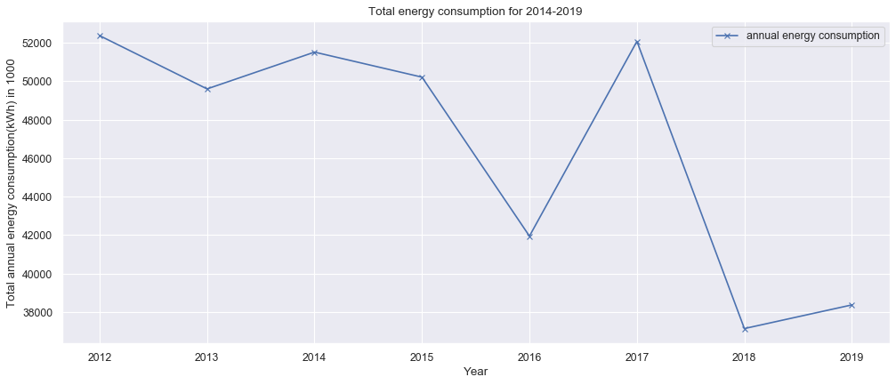
Total energy consumption in Nashville (2012-2019)
Notes:
Highest year being 2012, there is a decline trend lowest in 2019 as per the updated dataset on December 20, 2019

Slide 28
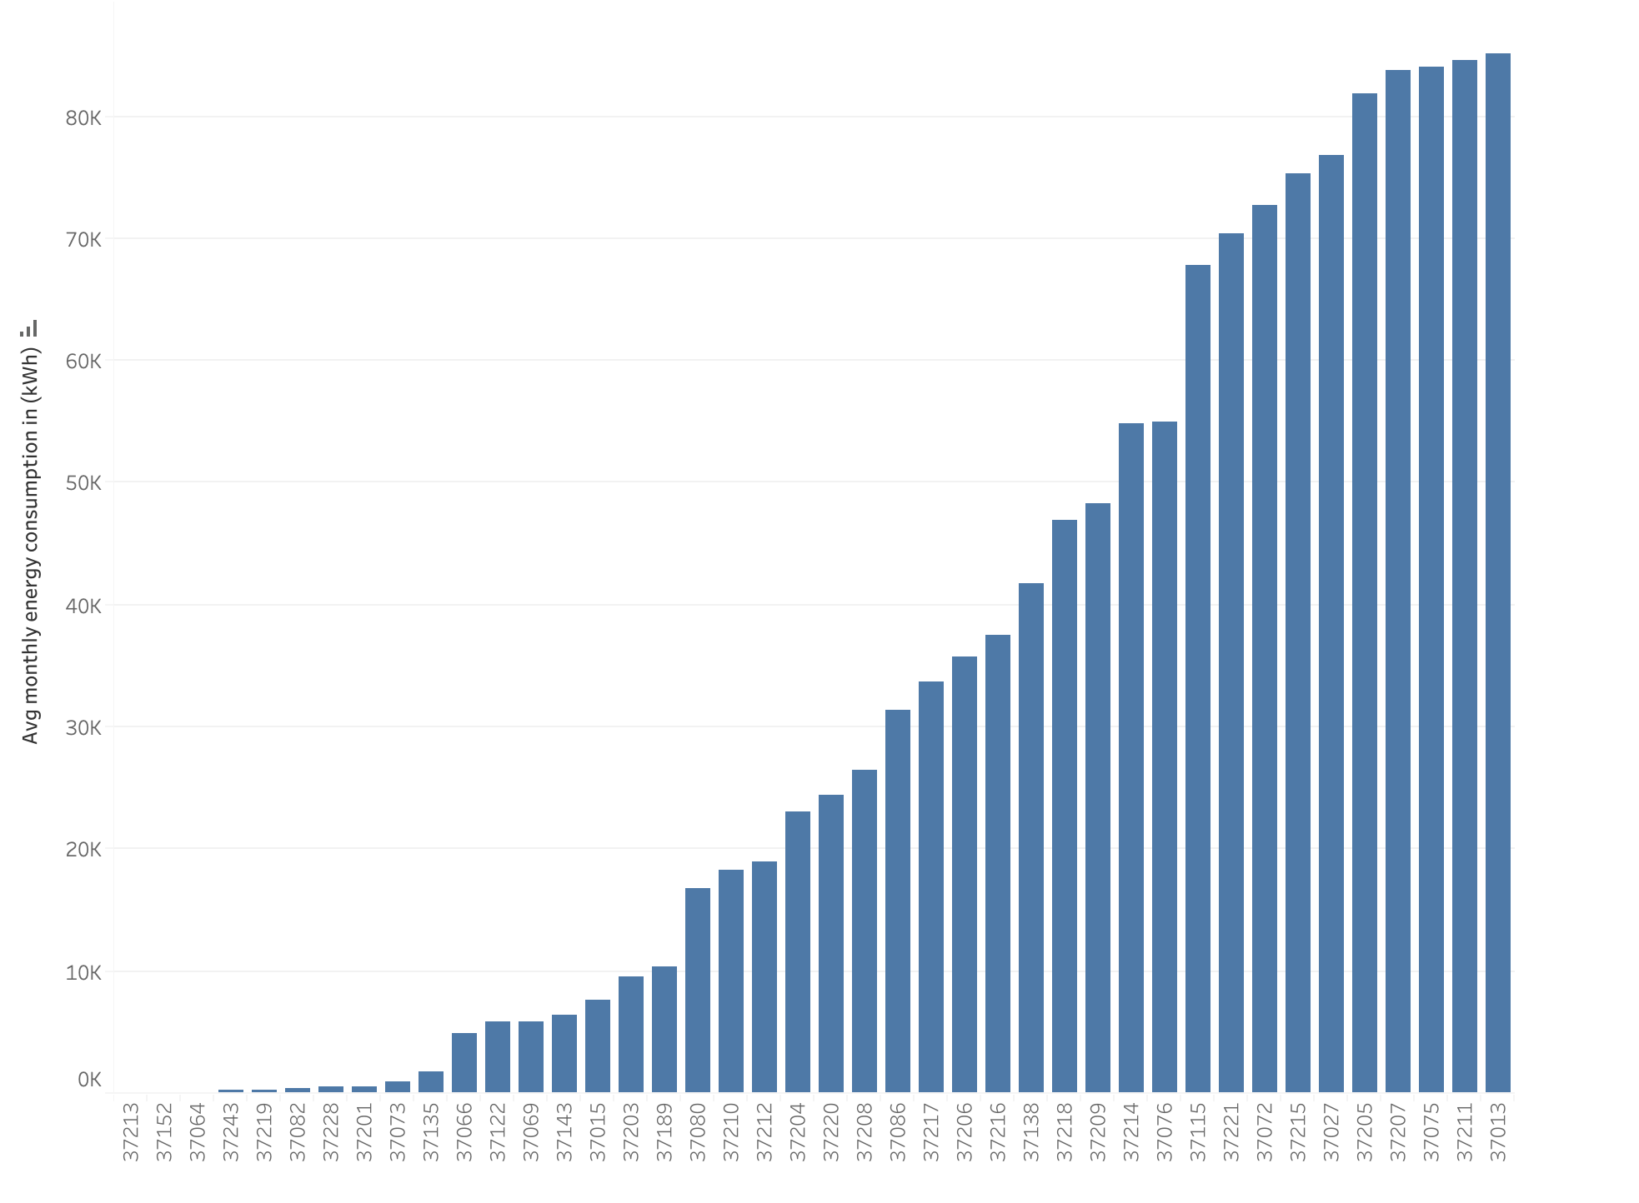
Avg monthly energy consumption per ZIP Code
Zip code
Notes:
Average annual electricity consumption for a U.S. residential utility customer was 10,972 kilowatthours (kWh), an average of about 914 kWh per month. Tennessee had the highest annual electricity consumption at 15,394 kWh per residential customer as per U.S. Energy information administration.

Slide 29
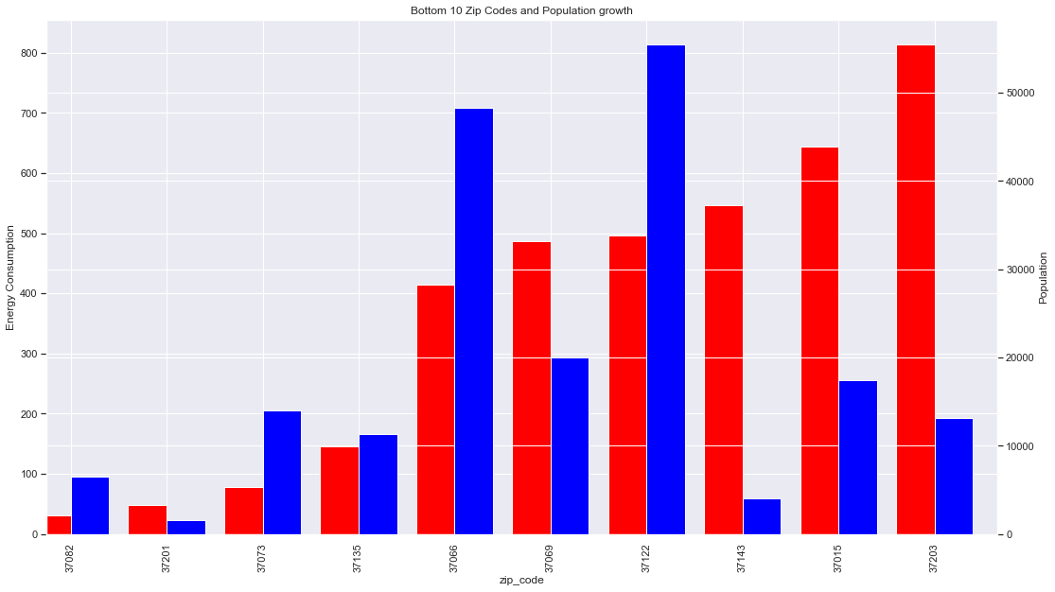
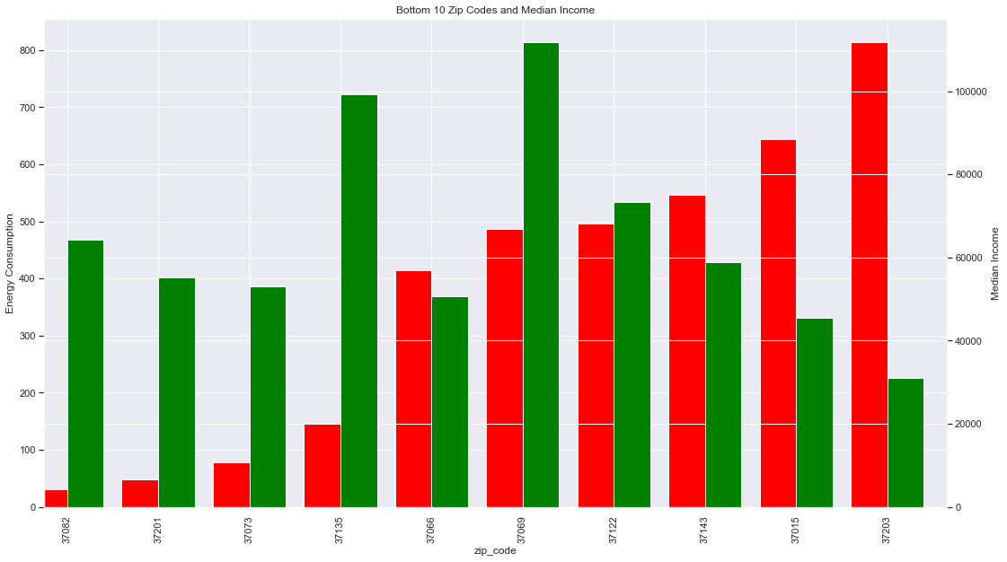
Population growth and median income?
Notes:
Decline in average energy consumption

Slide 30
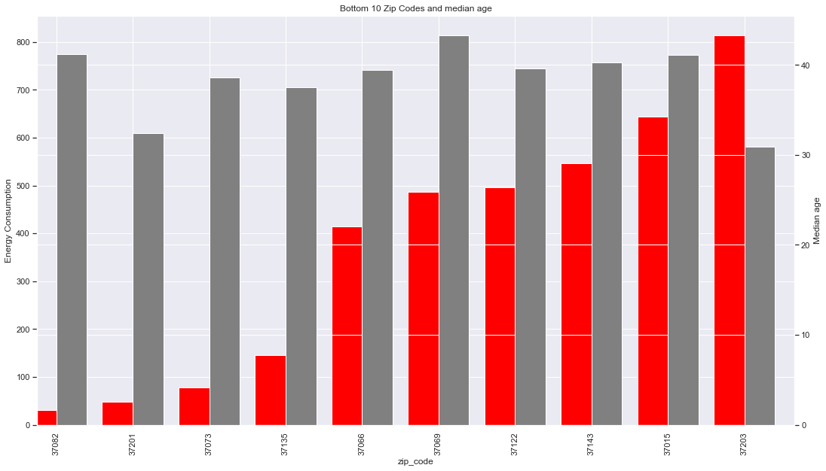
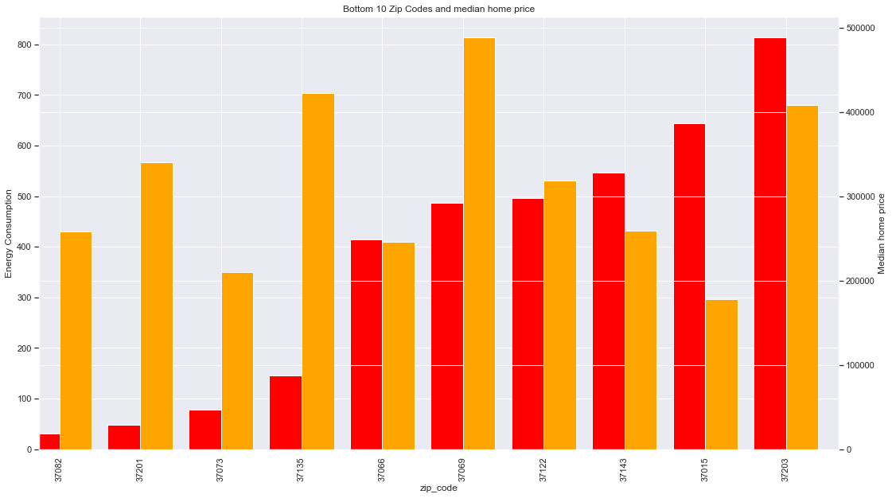
Median age and median home price?
Notes:
Decline in average energy consumption

Slide 31
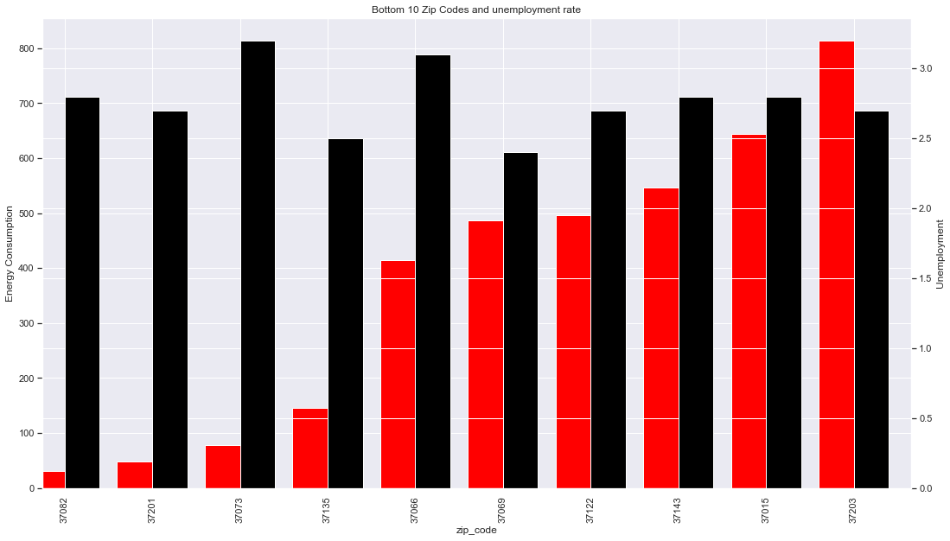
Unemployment?
Notes:
Decline in average energy consumption

Slide 32
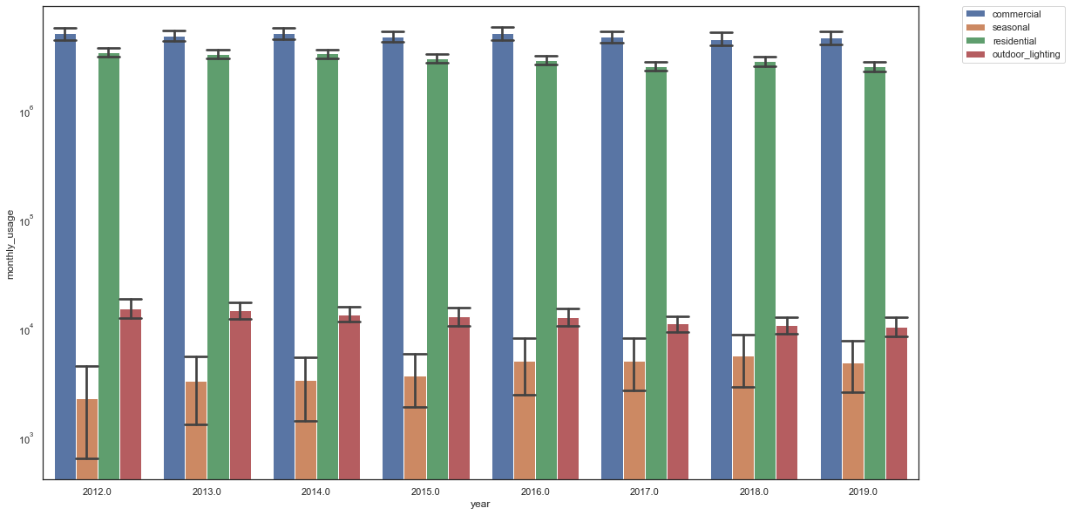
Energy consumption trends over the years
Notes:
SD error bars

Slide 33
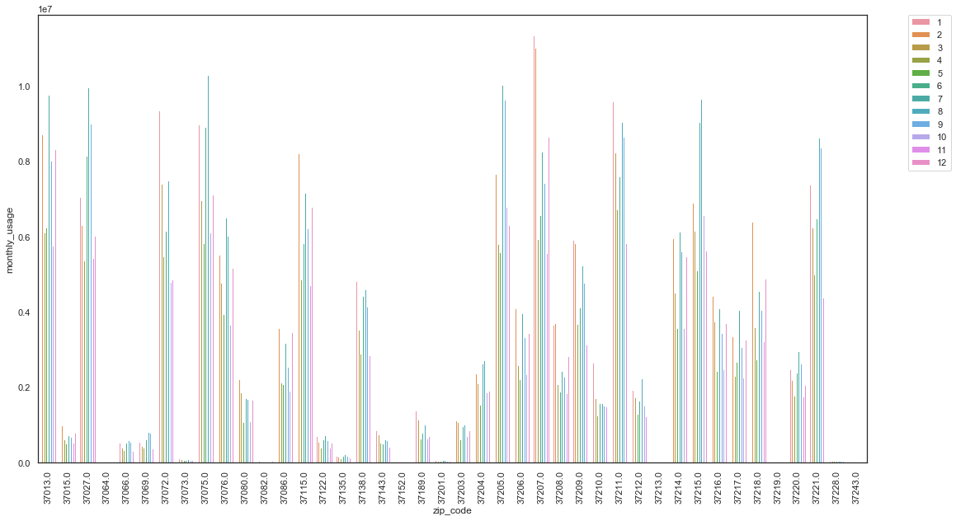
Residential monthly energy consumption
Notes:
Line plot could be better
Annual avg of each zip code

Slide 34
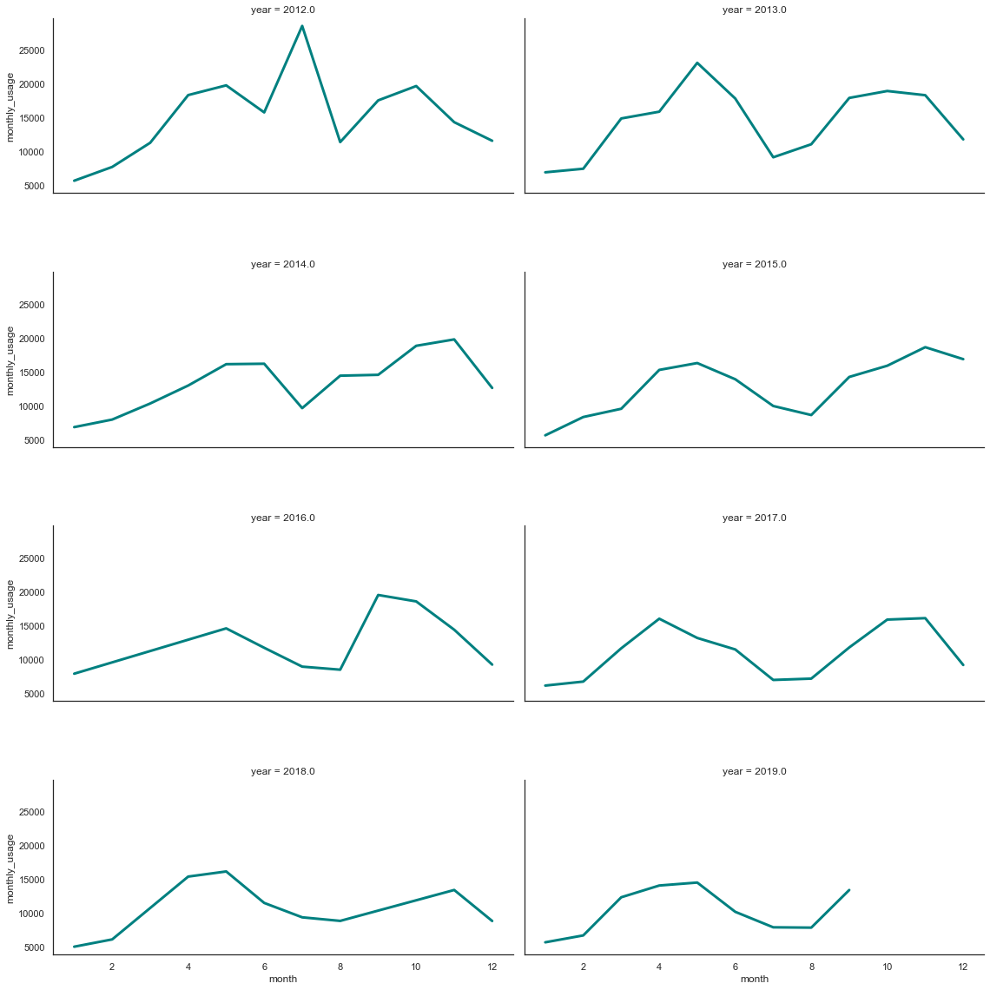
Monthly energy consumption per year ermonth

Slide 35
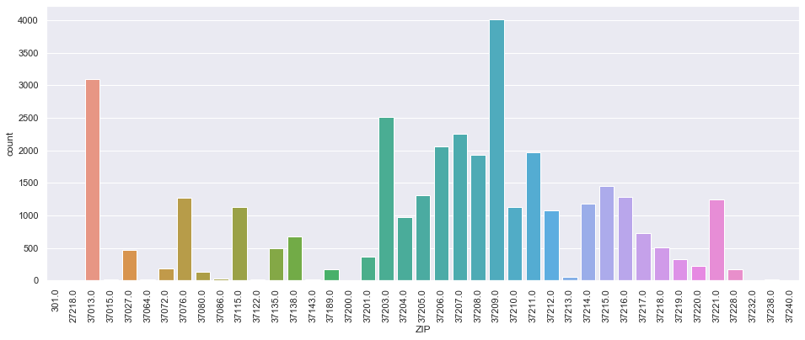
Total building permits issued
Notes:
Permits issued between 2015

Slide 36
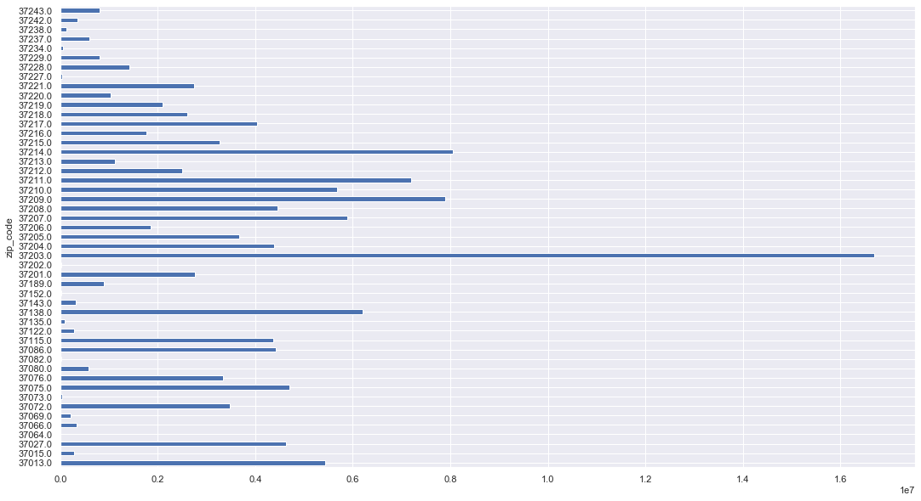
Total energy consumption per zip code

Slide 37
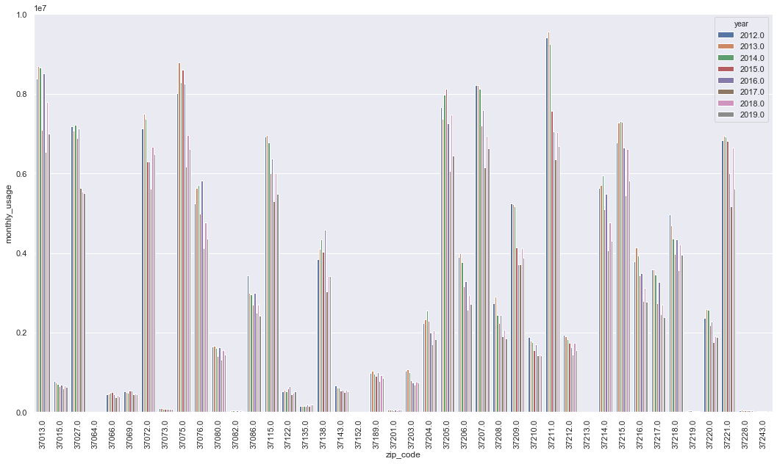
Residential annual energy consumption per zip code
Notes:
2012/2018 comparison graph
Average annual electricity consumption for a U.S. residential utility customer was 10,972 kilowatthours (kWh), an average of about 914 kWh per month. Tennessee had the highest annual electricity consumption at 15,394 kWh per residential customer as per U.S. Energy information administration.

Slide 38
